Slide 1
Practical Steps to Secure your APIs for Mobile
Mark O’Neill
VP Innovation, Axway

Slide 2


About me
Co-founder of Vordel (SOA/API Gateways)
  Acquired by Axway in 2012
VP Innovation at Axway
Based in Boston, MA
Blog: www.soatothecloud.com

Slide 3
Agenda
APIs for Mobile
  “Digital Business”
Security issues for APIs
  Data harvesting
  API Key sniffing
  Insecure use of plain HTTP
OAuth
  What can go wrong?
  OAuth model applied to Mobile
Solutions
  API Management
  “Certificate Pinning”

Slide 4



“Digital Business”
Creating new channels for revenue
  Cloud, Mobile, Social
  Over 3 hours per day on smartphones [Analysys Mason]
Notes:
Joke: Digitilization in French means “about fingers”.

Slide 5
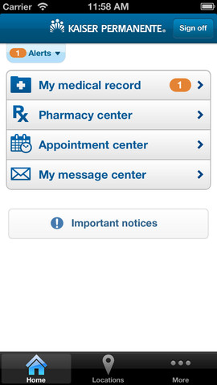
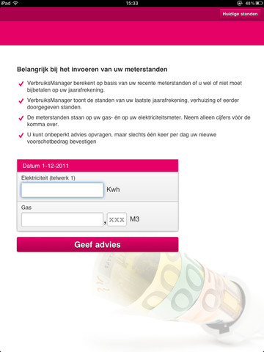
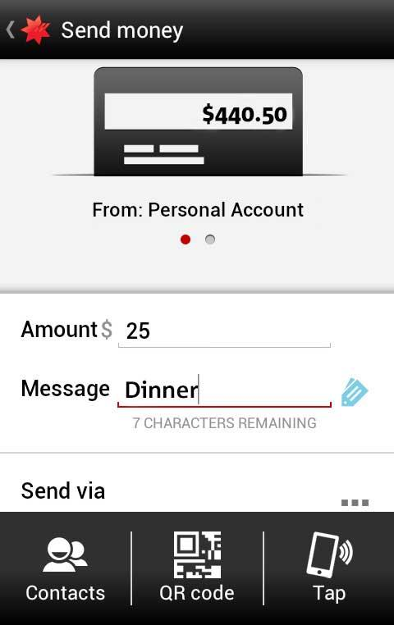
Where do APIs fit in?
  Enabling mobile apps
Health Records…
Utility Metering…
Payments
All get their data through APIs

Slide 6
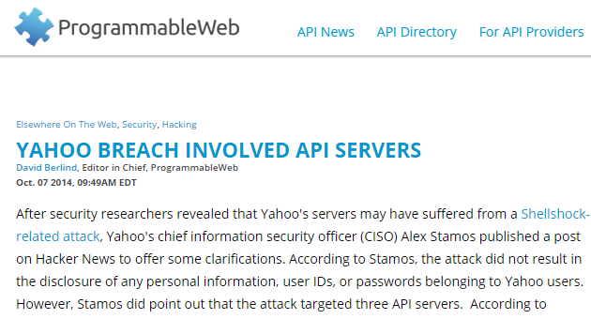
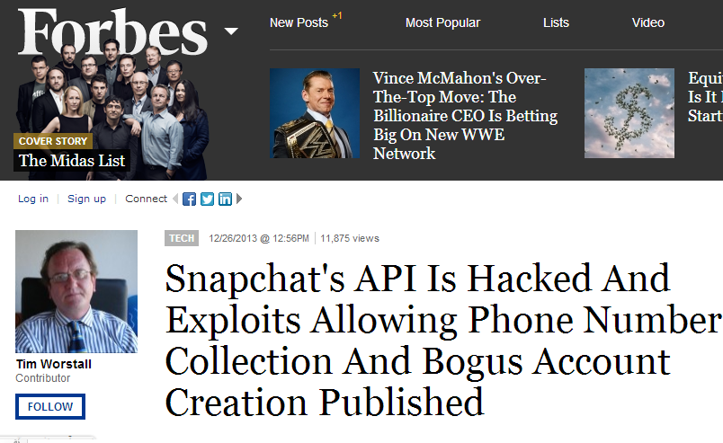
APIs – A soft underbelly?
Security vulnerabilities related to APIs

Slide 7

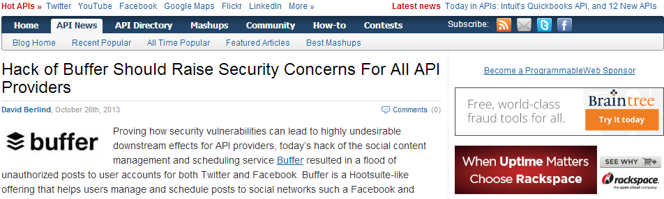
API Security

Slide 8
Identity - Key
Users often allow the app to interact with APIs on their behalf
  e.g. call the Twitter API to send tweets
Protection of OAuth credentials is important
“Permission-based Web”

Slide 9

OAuth Actor Model applied to Mobile:
Count the credentials…
Developer Portal
The User
App Developer
+--------+ +---------------+
| |--(A)- Authorization Request ->| Resource |
| | | Owner |
| |<-(B)-- Authorization Grant ---| |
| | +---------------+
| |
| | +---------------+
| |--(C)-- Authorization Grant -->| Authorization |
| Client | | Server |
| |<-(D)----- Access Token -------| |
| | +---------------+
| |
| | +---------------+
| |--(E)----- Access Token ------>| Resource |
| | | Server |
| |<-(F)--- Protected Resource ---| |
+--------+ +---------------+
Developer Portal Credentials
Resource Owner
Resource Owner Credentials
Client
Authorization Server
API Business Owner
Client API Credentials
Access Token
Resource Server
Refresh Token
The App
The API

Slide 10

More API Misuse – Why throttling is needed

Slide 11
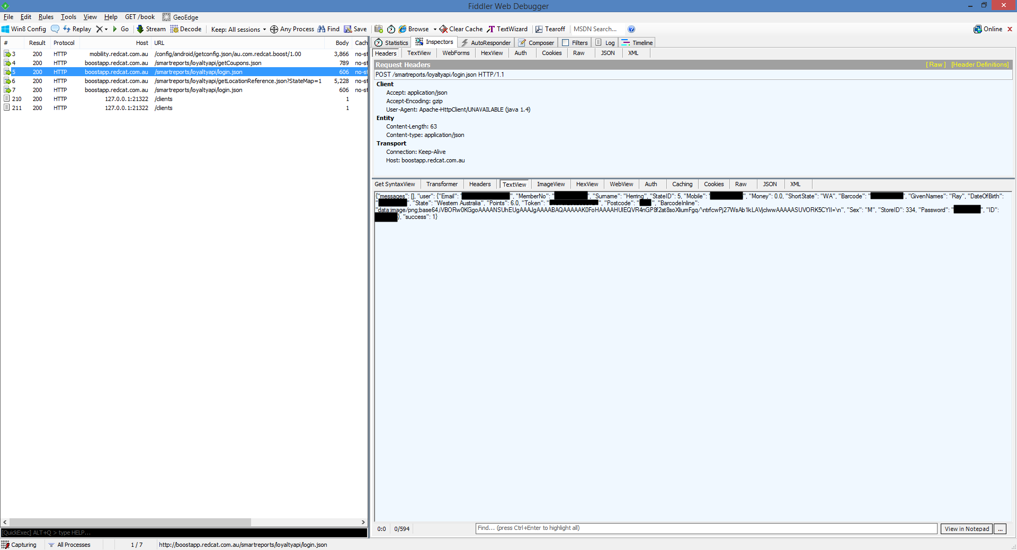
Insecure use of plain HTTP
Source:
http://www.troyhunt.com/2014/10/find-crazy-stuff-in-mobile-app.html

Slide 12
Weak API Key Authentication
Problem:
  API Keys are often simply passed in URLs
    &APIKey=123456
  Vulnerable to sniffing if SSL isn’t used (often it is not..)
Amazon uses two keys:
  Secret Key ID to perform HMAC signing
    With detection of replay attacks
  Access Key ID to identify the client

Slide 13


Enter API Management…
API Portal
API Manager
Self-service internal and external developers
to use APIs
Publish and Manage API Consumption by internal and external partners
API Gateway
Manage and Secure
API, SOA and XML traffic
On Premise

Slide 14
API First
APIs
SOA/ESB
The API is the contract
…And the product
WSDL is the Contract
Backend App is the Product
Courtesy of Kevin Kohut, Accenture ( @Kkohut )

Slide 15
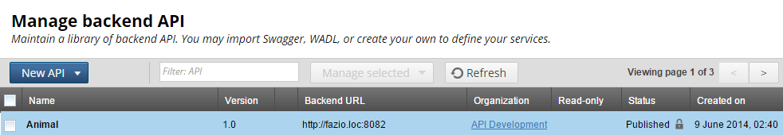
API Catalog
Lifecycle Management of APIs
Versioning
“Single Store of Truth”
The API Catalog is the modern-day Registry Repository
Version
Lifecycle Info

Slide 16
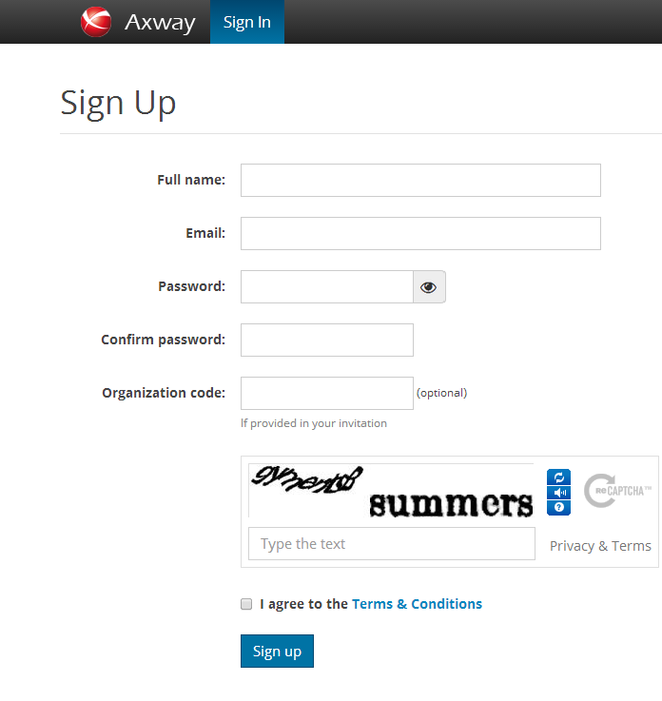
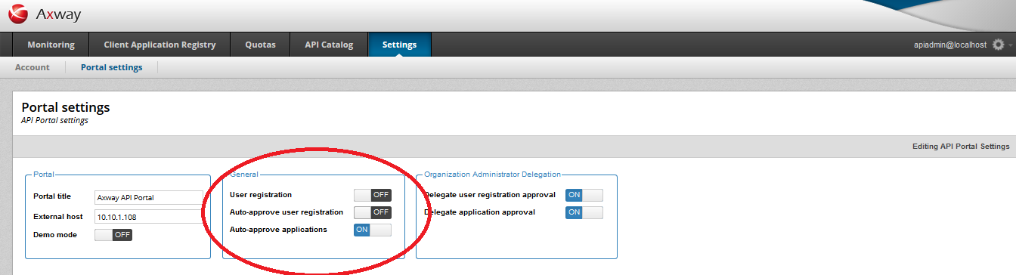
Self Service
Self-Service Developer Enrollment
Registration workflows

Slide 17
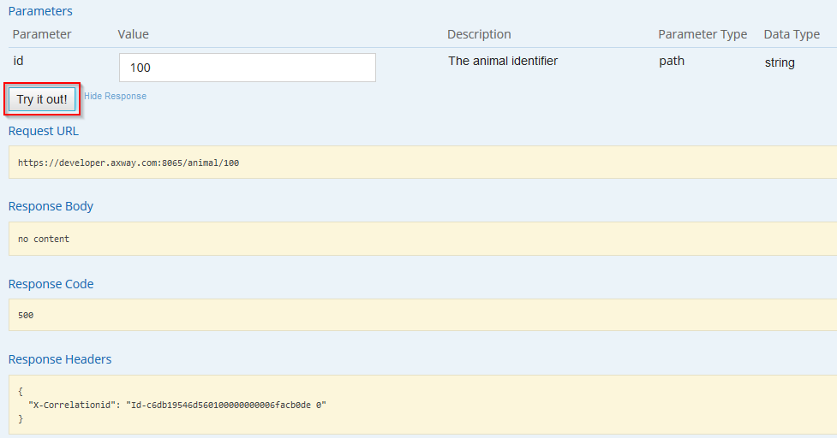
In-place API Testing
Test-as-you-go
“Try it out” for API Methods
Including using API Keys…

Slide 18
Stakeholders in API Management
Register and manage API lifecycle
Perform partner, policy and process admin
Monitor and report API use
Self-register to resources
Browse and learn APIs
Manage application credentials
API Manager
API Portal
API Administrators
API
API Registration & Lifecycle
Application Developers
API Developers
Self-Service API consumption
Build developer community
New channel to market brand
API Catalog
Partner & Policy Administration
Client Applications
REST
API Gateway
Applications
REST API
SOAP/XML/REST/JSON
Services
Policy Enforcement
SOAP Web Services
POX, JMS, FTP
Data
Create and extend policies
Integrate with applications and infrastructure
Policy Developers
Integration with non-REST API services
Notes:
Self-service API consumption
Developers can browse APIs and register applications
Build a partner and developer community around the APIs
New channel to promote brand
API catalog
Browseable registry of APIs
API lifecycle management
Register, publish, version, deprecate
API administration
Client administration & policy management
Monitor & manage API usage
API policy enforcement
API proxy for enforcing common policies

Slide 19
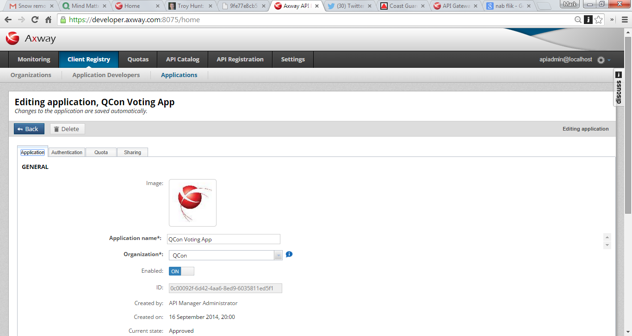
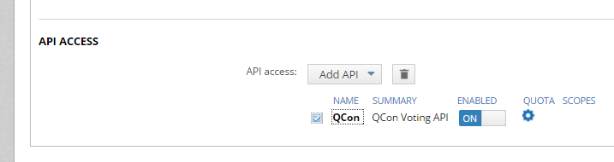
Managing mobile app access to APIs

Slide 20
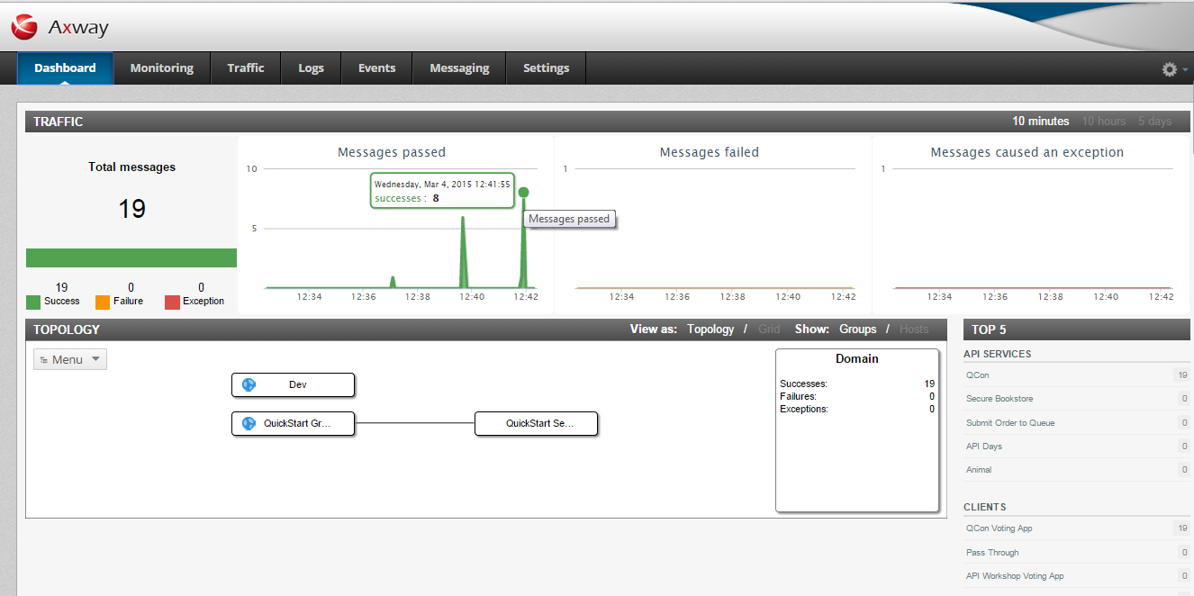
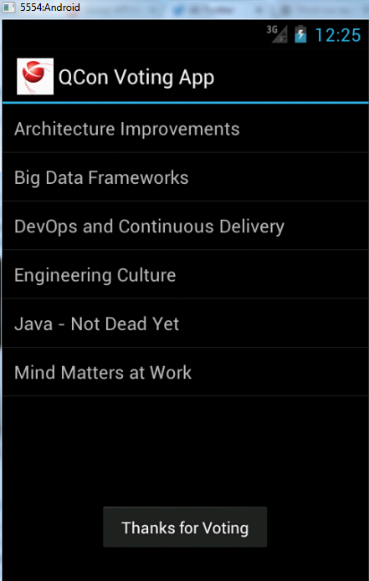
Mobile App Monitoring in Action

Slide 21
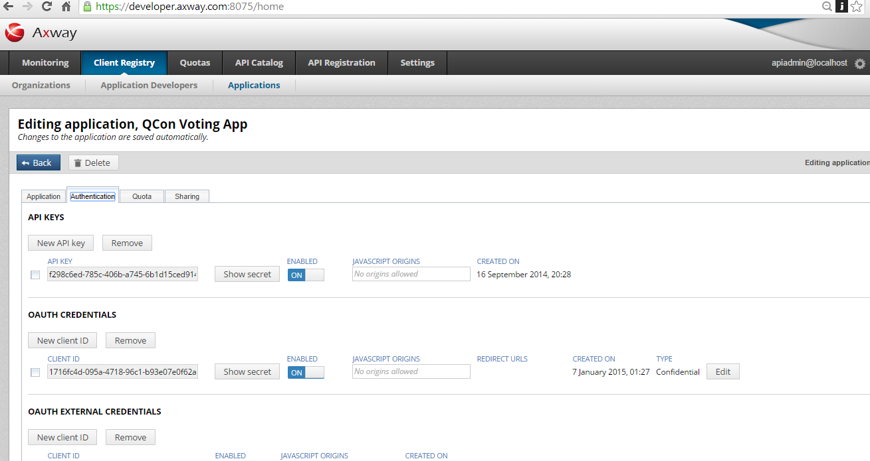
Managing API Keys and OAuth

Slide 22
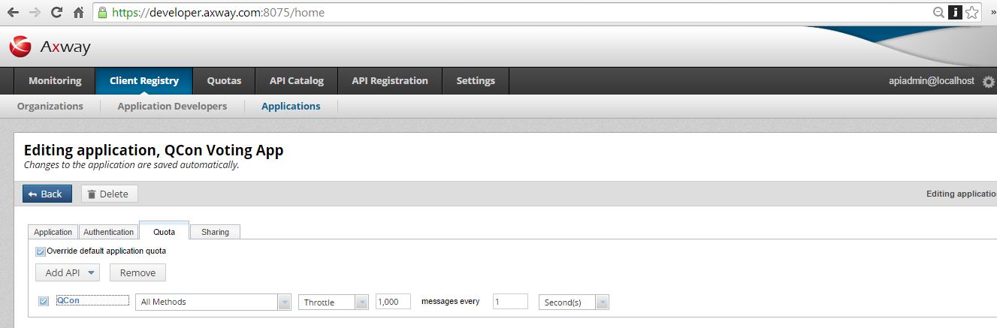
Quota Management for APIs
Managing usage quotas for APIs on an app-by-app basis

Slide 23
Certificate Pinning
Problem:
  API Keys are vulnerably when stored on the client
Solution: “Certificate Pinning”:
  Leverages native mobile OS support for protecting certificates
  Uses Mutual SSL
  End-user credentials (e.g. username/password) then sent over this Mutual SSL connection

Slide 24

Further questions
@Axway
@TheMarkONeill
Visit us at the Axway Booth
Thank you!

