Slide 1


When bet365 met Riak and discovered a true, “always on” database

Slide 2
At small scale things work just fine

Slide 3
AT LARGE
SCALE
THINGS
BREAK

Slide 4

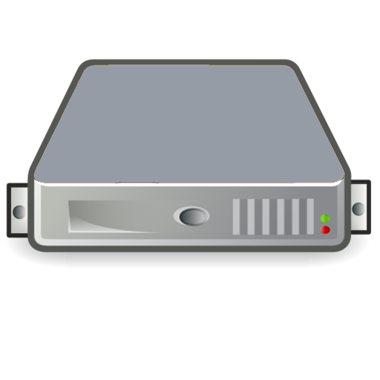



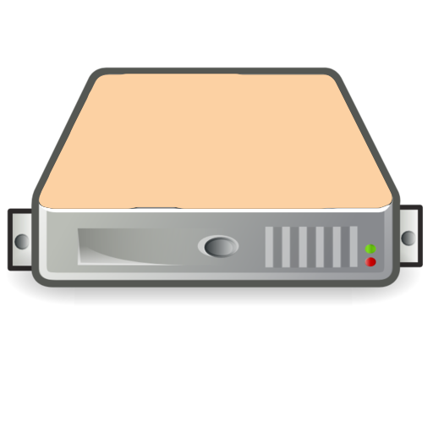
The New Generation of Databases
In 2014, 20% of data projects add distributed processes into production

Slide 5
RELATIONAL, HADOOP, NOSQL
What’s the difference?
Relational
Database
Structured Data
Defined Schema
Tables with
Rows/Columns
Indexed
w/ Table Joins
SQL
Hadoop
Unstructured Data
HDFS
Large-scale analytics over volumes of data
MapReduce Spreads work across servers
Hadoop UI
Data Mining
NoSQL
Database
Unstructured Data
No pre-defined Schema
Small and Large Data Sets on Commodity HW
Many Models: K/V, document store, graph
Variety of Query Methods
CV
CV
CV

Slide 6



WHAT MAKES RIAK
UNIQUE
Scalability
Low-Latency
High Availability
Fault-Tolerance
Operational Simplicity
Multi-Model
Key/Value
Solr
Secondary Indexes
Map/Reduce
Multi- Datacenter Replication
24x7 Customer Support

Slide 7


Slide 8
MISSION CRITICAL

Slide 9

9

